Slide 2


Slide 3


Slide 4


X

Slide 5


Data Distributions
Probabilistic Distributions
X

Slide 6
Data Distributions
In this section we’ll explore concepts that will allow us to better understand different distributions of data.
X

Slide 7
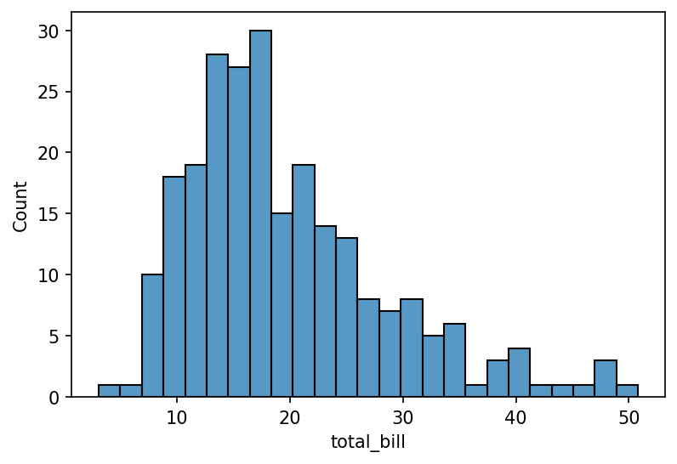
Data Distributions
Recall our discussions of data visualizations and histograms.
X

Slide 8
Data Distributions
Notice this is a visualization of how this particular dataset is distributed.
X

Slide 9
Data Distributions
When thinking about data sets, we can use data distributions to model outcomes, depending on how the data itself is actually distributed.
In this section we’ll explore how to understand distributions and some different types of common distributions.
X

Slide 10
Data Distributions
Data Distribution Section:
Probability Mass Functions
Discrete Uniform Distribution
Probability Density Functions
Continuous Uniform Distribution
Cumulative Distribution Functions
X

Slide 11
Data Distributions
Data Distribution Section:
Specific Distributions:
Binomial Distribution
Bernoulli Distribution
Poisson Distribution
X

Slide 12
Data Distributions
As you encounter data sets, you’ll begin to see behaviour and patterns in the distribution of the data that are actually common characteristics to a particular data distribution.
Matching a real world data set to a particular distribution can be a very powerful tool!
X

Slide 13
Data Distributions
For example, understanding that certain data sets, such as the heights of people, are normally distributed allows you to apply statistical operations related to normal distributions.
X

Slide 14
Data Distributions
Another example could be the Binomial Distribution which can help you model events in which you have a sequence of independent events.
This could be used by a casino to model the probability of winning on games such as BlackJack or Baccarat.
X

Slide 15
Data Distributions
Before we dive deeper into data distribution, let’s give you an intuition of how to think about data distributions, especially the differences between Probability Mass Functions and Probability Density Functions.
X

Slide 16
Data Distributions
Probability Mass Functions
X

Slide 17
Data Distributions
Probability Mass Functions
The formal definition of a probability mass function is: “a function that gives the probability that a discrete random variable is exactly equal to some value”.
X

Slide 18
Data Distributions
Probability Mass Functions
This definition can seem very intimidating and confusing at first glance, but if we break it down it’s actually pretty straightforward and unlocks a lot of potential use cases for us!
X

Slide 19
Data Distributions
Probability Mass Functions
A function simply takes in an input, applies some transformation, and returns an output.
For example f(x) = x+1 is a simple function that simply adds 1 to x, so that f(2)=3.
X

Slide 20
Data Distributions
Probability Mass Functions
A probability function is similar, except that is returns a probability value.
For a probability mass function, it returns the probability that a discrete random variable is exactly equal to some value.
X

Slide 21
Data Distributions
Probability Mass Functions
This means a probability mass function can be written as:
f(x) = P[X=x]
Where X is the discrete random variable and x is the certain value.
X

Slide 22
Data Distributions
Probability Mass Functions
Let’s explore a simple example of a discrete random variable in order to fully understand probability mass functions.
Imagine you are running a security test program on 100 employees, one of whom is the CEO.
X

Slide 23
Data Distributions
Probability Mass Functions
The security test program will send a phishing email to one random employee out of the 100 total employees.
What is the probability that the CEO will receive the test phishing email?
X

Slide 24
Data Distributions
Probability Mass Functions
Notice a few distinct features of the situation:
There are a discrete number of employees: 100.
We’re interested in the probability of a particular event outcome.
X

Slide 25
Data Distributions
Probability Mass Functions
This means we essentially have a probability mass function:
f(x) = P[X=x] = P[X=CEO]
X

Slide 26
Data Distributions
Probability Mass Functions
If we know there are only 100 employees and all have an equal (uniform) chance of being picked, then the odds of picking the CEO (P[X=CEO]) are simply 1/100, or 0.01, or 1% chance of picking the CEO.
X

Slide 27
Data Distributions
Probability Mass Functions
In this case, since the outcomes were discrete, we label this as a probability mass function.
It is the discrete outcomes that allow us to model this as a mass function. In this particular case, we had a discrete uniform distribution, but that’s not always the case!
X

Slide 28
Data Distributions
Probability Mass Functions
When visualizing probability mass functions, you will see distinct probability points for each outcome.
For example, if we only had 10 employees with equal chances of being chosen, what would the PMF distribution visual look like?
X

Slide 29
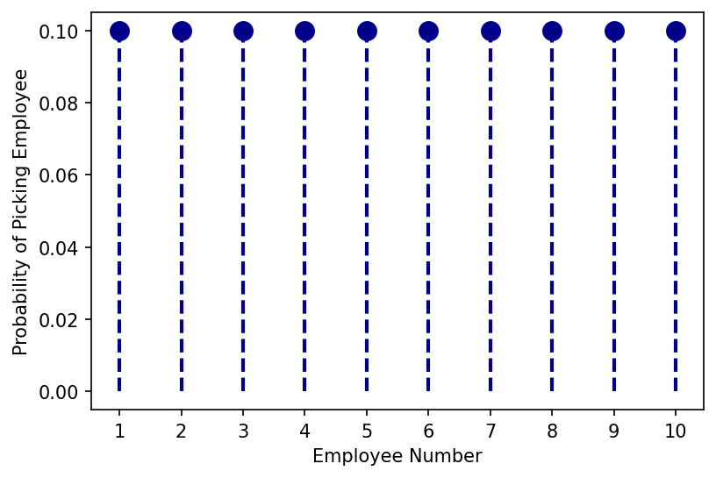
Data Distributions
Probability Mass Functions
PMF for 10 Employees with Uniform Chance
X

Slide 30
Data Distributions
Probability Density Functions
X

Slide 31
Data Distributions
Probability Density Functions
Now what happens in situations where the outcomes are not discrete? For example, instances where the outcomes are continuous.
In this case we’re dealing with a probability density function!
X

Slide 32
Data Distributions
Probability Density Functions
Now what happens in situations where the outcomes are not discrete? For example, instances where the outcomes are continuous.
In this case we’re dealing with a probability density function!
X

Slide 33
Data Distributions
Probability Density Functions
The formal definition of a probability density function: a function whose value at any given sample in the sample space can be interpreted as providing a relative likelihood that the value of the random variable would be close to that sample.
X

Slide 34
Data Distributions
Probability Density Functions
This appears similar to the PMF definition, but the key difference is that we’re working with a continuous random variable instead of a discrete random variable.
This requires a small shift in our mindset…
X

Slide 35
Data Distributions
Probability Density Functions
Imagine that we’re going to send out the test phishing emails to multiple accounts using a 3rd party service. Typically once we hit send, the emails are sent out in 1-3 minutes after we hit send. Note how this is a continuous random variable, since it is minutes.
X

Slide 36
Data Distributions
Probability Density Functions
What if we wanted to know the probability that the emails get sent at exactly the 1 minute mark? Does that question even make sense? It’s almost impossible that the emails will be sent at exactly 60.0000000… seconds after we hit “send”.
X

Slide 37
Data Distributions
Probability Density Functions
For continuous random variables we switch our thinking from exact outcomes (which we did for discrete random variables) to either approximations or interval ranges.
X

Slide 38
Data Distributions
Probability Density Functions
For example it would be more useful to know the P[X < 1min].
This allows us to answer the question: What is the probability that emails are sent out in 1 minute or less?
X

Slide 39
Data Distributions
Probability Density Functions
There are many different types of probability density functions, such as a Normal distribution or a Boltzmann distribution.
X

Slide 40
Data Distributions
Data Distribution Concepts
In fact, there are so many different types of distributions, that you can view a list of them on Wikipedia:
en.wikipedia.org/wiki/List_of_probability_distributions
X

Slide 41
Data Distributions
Data Distribution Concepts
The key insight for understanding data distributions is that once you can connect a real world set of events or data points to a particular data distribution, you can leverage properties of that distribution to calculate probabilities.
X

Slide 42
Data Distributions
Data Distribution Concepts
For example, recall in our example of probability mass functions with security phishing emails, we knew it as a discrete uniform distribution.
X

Slide 43
Data Distributions
Data Distribution Concepts
Discrete uniform distributions have the property that the probability of a single discrete outcome is simply 1/N where N is the number of discrete event possibilities, in our example N was 100 employees, thus the CEO had a 1/100 probability of being picked.
X

Slide 44
Data Distributions
Data Distribution Concepts
A discrete uniform distribution is a simpler case, but there are many real world situations that match up to more complex data distributions, where calculating event probabilities would be difficult without referencing prior work or proofs.
X

Slide 45
Data Distributions
Data Distribution Concepts
Fortunately for us, mathematicians of the past such as Bernoulli have already done the hard work for us, and we can stand on their shoulders to quickly assess what formulas to use once we know the data distribution we’re working with!
X

Slide 46
Data Distributions
Let’s continue exploring data distributions as well as taking a deeper dive into the concepts discussed in this lecture!
X

